Slide 1
B.Tech CSE, 4th Semester Operating System

Slide 2
Operating System Lab -2
Introduction to Linux file Commands

Slide 3
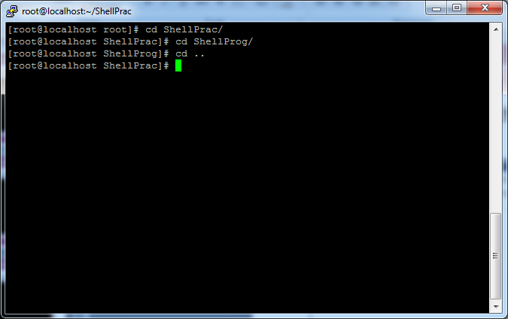
Command: cd
To change to a specific directory use “cd”

Slide 4
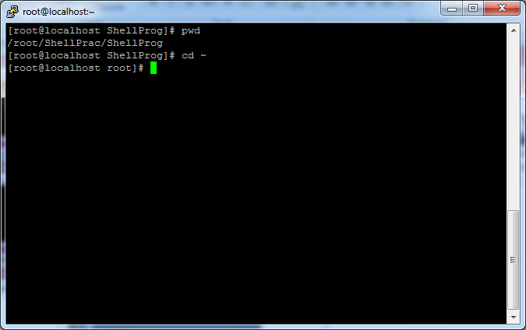
Command: cd
“~” is the location of your home directory

Slide 5
Command: cd
“..” is the location of the parent directory

Slide 6
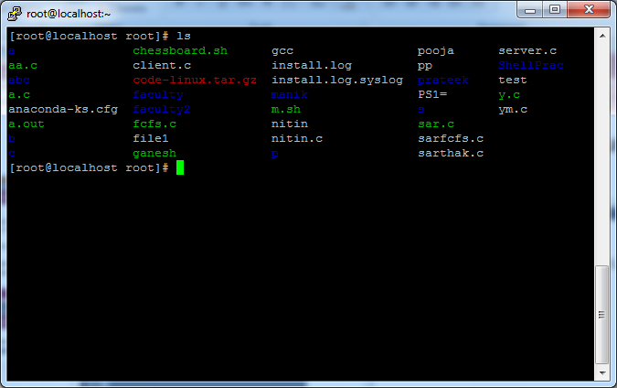
Command: ls
To list the files in the current directory use “ls”

Slide 7
Command: ls
ls has many options
-l long list (displays lots of info)
-t sort by modification time
-r reverse the order
“man ls” for more options
Options can be combined: “ls -ltr”

Slide 8
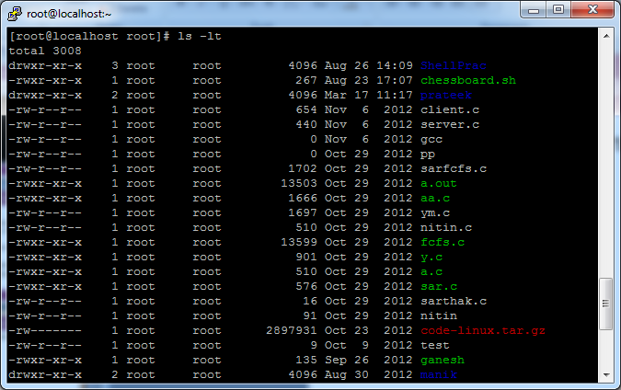
Command: ls -lt
List files by time in reverse order with long listing

Slide 9
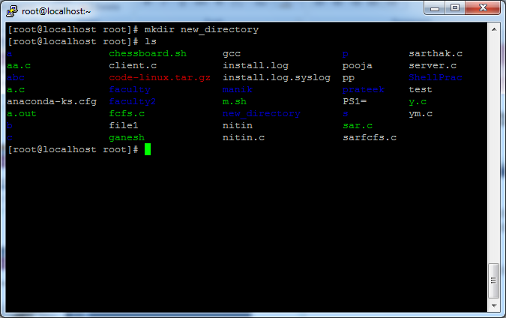
Command: mkdir
To create a new directory use mkdir
Linux mkdir Command Syntax
The syntax for the mkdir command is as follows:
mkdir [OPTION] [DIRECTORY]
The command takes one or more directory names as its arguments.

Slide 10
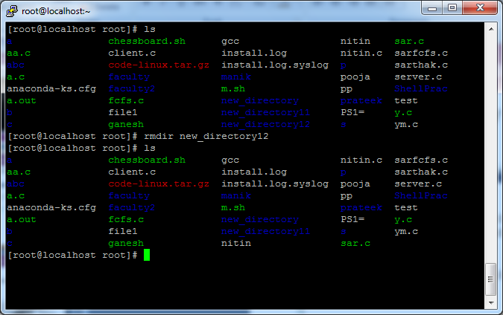
Command: rmdir
To remove and empty directory use “rmdir”

Slide 11
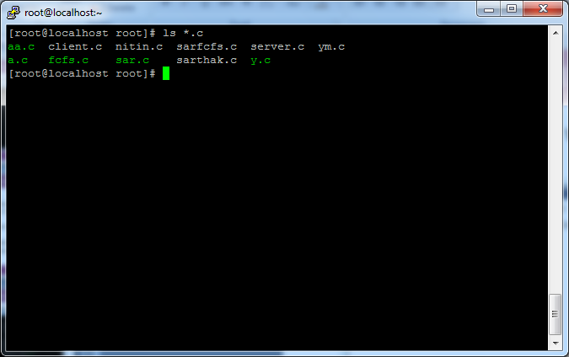
General Syntax: *
“*” can be used as a wildcard in unix/linux

Slide 12
Soft link & Hard Link
Soft Link –> ln –s filename soft_link name
Hard link –> ln filename hard_link name

Slide 13
File Commands
Copying a file: cp
Move or rename a file: mv
Remove a file: rm

Slide 14
How to copy a file
To copy a file with the cp command pass the name of the file to be copied and then the destination.
Comand : cp source_file destination_file

Slide 15
How to copy multiple files
To copy multiple files using the cp command pass the names of files followed by the destination directory to the cp command.
cp file1 file2 directory_name

Slide 16
How to copy a directory
By default the cp command will not copy directories. Attempting to copy a directory results in an error.
To copy a directory pass the -R flag. This will recursively copy a folder and create a copy.
Cp –r directory1 destination_directory

Slide 17
How to copy multiple directories
Cp –r directory1 directory2 destination_directory

Slide 18
interactive cp
Cp –i source_file dest_file

Slide 19
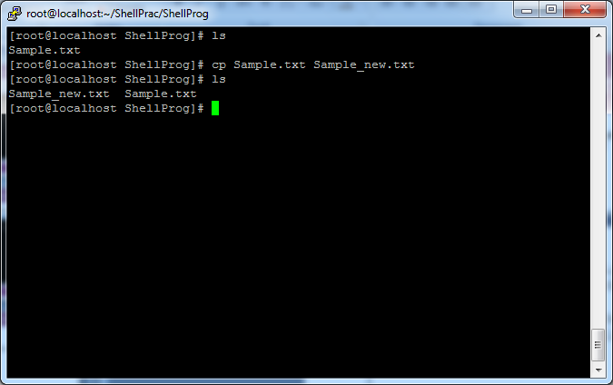
Command: cp
To copy a file use “cp”

Slide 20
mv command
The mv command is a command moves files or directories from one place to another

Slide 21
How to move file
To move a file using the mv command pass the name of the file and then the new name for the file
mv file1 file2
In above example file1 is renamed to file2

Slide 22
How to move a file into a directory
To move a file into a directory using the mv command pass the name of the file and then the directory
mv file_name directory
mv file_name directory_name/filename

Slide 23
How to move multiple files into a directory
To move multiple files using the mv command pass the names of the files or a pattern followed by the destination.
mv file1 file2 file3 destination_directory

Slide 24
How to move a directory
mv directory1 directory2

Slide 25
How to prompt before overwriting a file
mv –i file1 file2

Slide 26
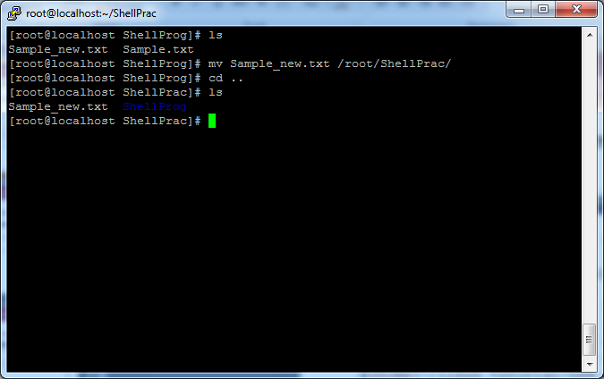
Command: mv
To move a file to a different location use “mv”

Slide 27
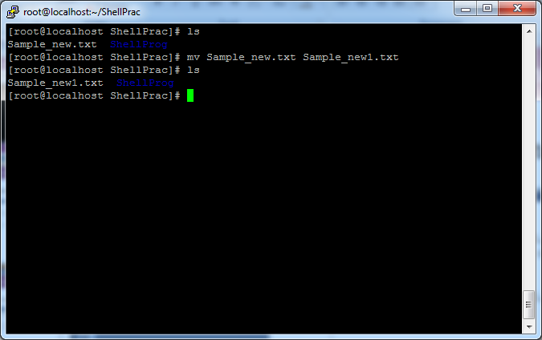
Command: mv
mv can also be used to rename a file

Slide 28
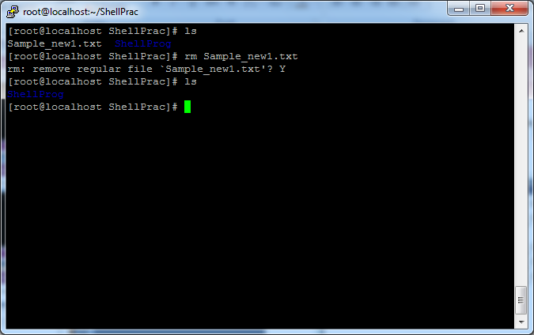
Command: rm
To remove a file use “rm”

Slide 29
Command: rm
To remove a file “recursively”: rm –r
Used to remove all files and directories

